Slide 1
Introduction to Simulation and the SIMBOX
Joyce Li MD MPH
Division of Emergency Medicine
Boston Children’s Hospital

Slide 2
Objectives
Introduction to Simulation
Why use simulation in healthcare?
Bloom’s Taxonomy
Core principles
Debriefing
SIMBOX

Slide 3
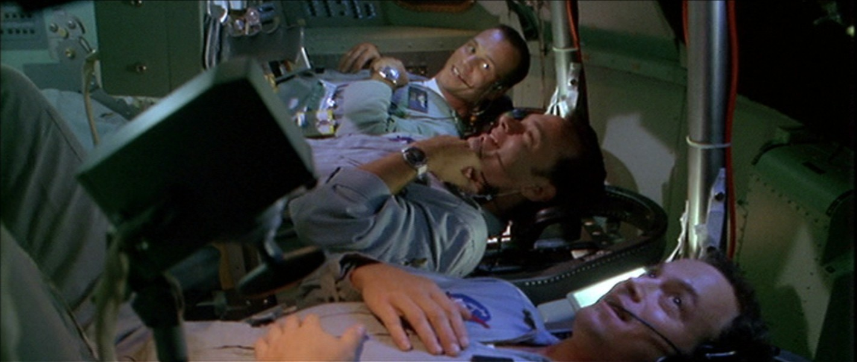
Apollo 13

Slide 4
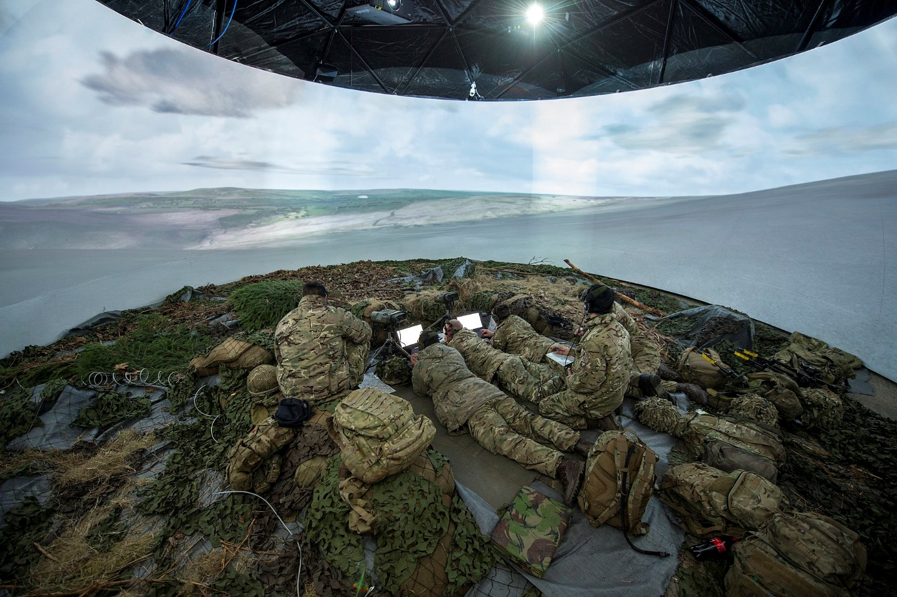
Simulation
War games are the use of simulation in the military and were first used in 1866
By Photo: Sgt Si Longworth RLC (Phot)/MOD, OGL v1.0, https://commons.wikimedia.org/w/index.php?curid=42137627
Notes:
Pic of uk military simulation

Slide 5
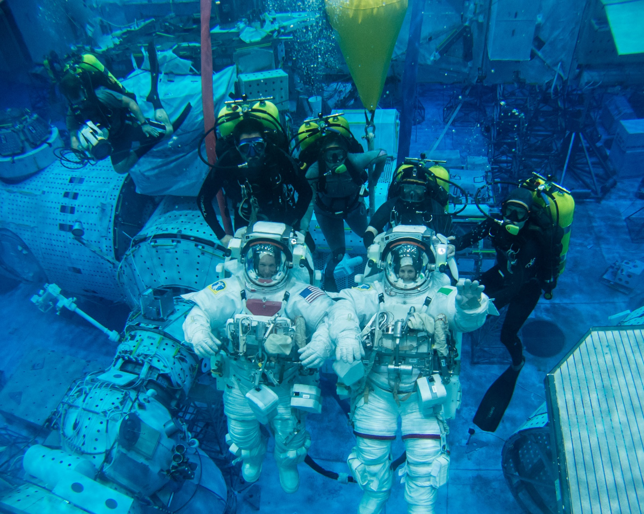
Spacenews.com
Aerotime.aero
Notes:
Examples were sim are standard operating procedure

Slide 6
Why Simulation?
Simulation can help improve patient safety through education and assessment
Advantages of simulated environment
A safe space to make mistakes and learn from them
Practice rare events
Allows for hands on practice for patient care and in teamwork
Can be adapted to a variety of educational levels and purposes
Ref: Society of Simulation in Healthcare

Slide 7
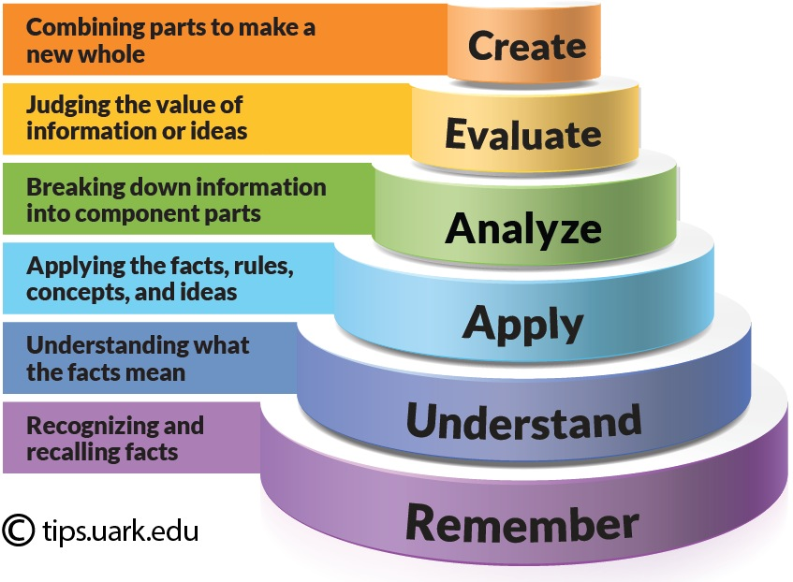
Bloom’s Taxonomy --Way to think about teaching and learning --Hierarchical order of cognitive skills that classifies learning outcomes and objectives
Notes:
Remember: Knowledge
Understand: Comprehension Illustrating by organizing, comparing, translating, interpreting, giving descriptions, and stating the main ideas
Analyze: Analysis of elements
Analysis of relationships
Analysis of organization

Slide 8
Simulation and Blooms Taxonomy
Level | Action | Example
Remember (Knowledge) | Memorize Facts | Recite PALS algorithm for shockable arrest
Understand (Comprehension) | Understand Facts | Select correct pediatric dose for defibrillation
Apply | Apply facts correctly | Demonstrate how to apply defibrillation for 5 year old child (Sim)
Analyze | Break down information | Identifying different arrhythmias and applying the correct algorithm to a pediatric patient (Sim)
Evaluate | Calculate the value of info | Manage a pediatric cardiac arrest that does not respond to initial interventions (Sim)
Create (Synthesis) | Combine parts into a new whole | Manage an interdisciplinary team during a pediatric cardiac arrest (Sim)
Ref: Based on https://www.umuc.edu/ugp/ewloomtax.html

Slide 9
Core Principles
Basic Assumption: All participants are intelligent, well trained, well intentioned and want to learn to continue to improve (Center for Medical Simulation)
Try to suspend disbelief
Pediatric Readiness
Confidentiality
Non-evaluative
Support and help each other

Slide 10
Debriefing
Debriefing allows for structured reflection and discussion
Why debrief?
By breaking down and discussing event, you can identify what did and didn’t work, what needs improvement and develop strategies to move forward
Debriefing techniques used in sim can be used for general code debriefs
Code debriefs can help medical staff process traumatic events

Slide 11
Debriefing
Set expectations
Reactions
Description
Analysis
Reinforce learning
Summary and Application

Slide 12
Debriefing
Set expectations-The goal of the debriefing is for open, non judgmental discussion for the purposes of learning and what can be improved.
Reactions
Description
Analysis
Reinforce learning
Summary and Application

Slide 13
Debriefing
Set expectations
Reactions-Allows for participants to decompress about how they felt about the sim before launching into medical discussion
Description
Analysis
Reinforce learning
Summary and Application

Slide 14
Debriefing
Set expectations
Reactions
Description-Have one person (usually team leader) summarize what happens and correct if needed, helps make sure that everyone is on the same page about what happened during the case
Analysis
Reinforce learning
Summary and Application

Slide 15
Debriefing
Set expectations
Reactions
Description
Analysis-This is the heart of debriefing, allow participants to identify what went well and what they may do differently next time
What do you think went well?
If you could do the case again, what would you do differently? Or If a similar case come in again tomorrow, what might you do differently?
Reinforce learning
Summary and Application

Slide 16
Debriefing
Set expectations
Reactions
Description
Analysis
Reinforce learning- Provide focused feedback and any observations
Can be incorporated as a part of analysis
Summary and Application

Slide 17
Debriefing
Set expectations
Reactions
Description
Analysis
Reinforce learning
Summary and Application- Identify at least one take home point and wrap up the case.

Slide 18
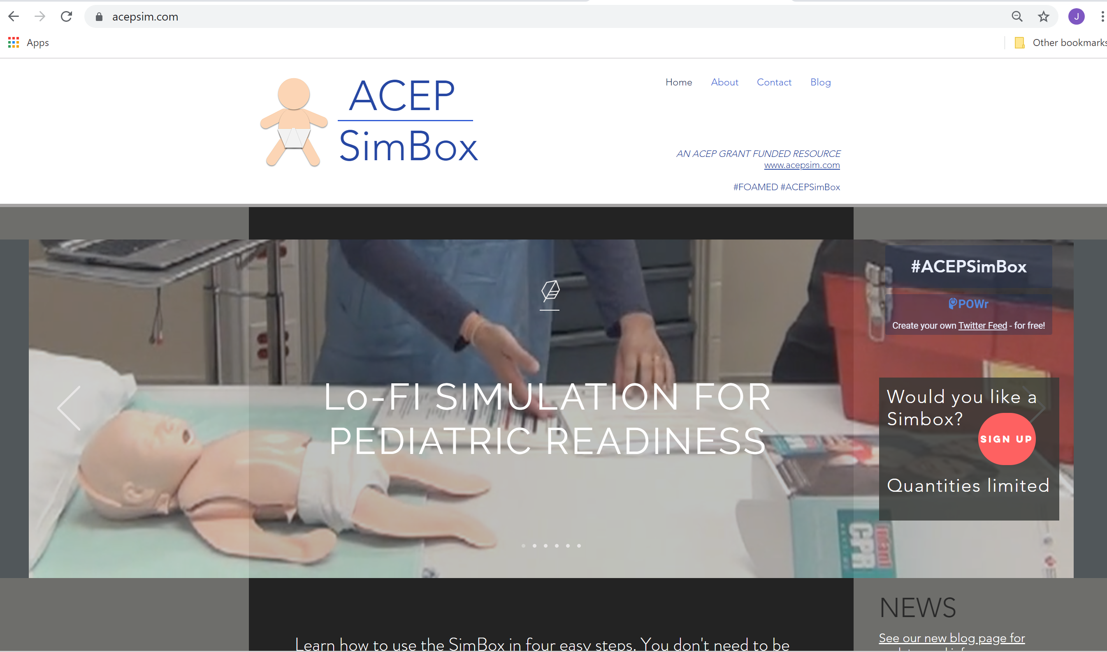
ACEP SIMBOX
Critically ill pediatric patients are relatively rare events, particularly in the community setting.
How to keep up to date on skills?

Slide 19
ACEP SIMBOX
Purpose
Improve readiness to triage and treat a sick neonate
Readiness could be improved in multiple ways using the sim to help:
Identify necessary equipment
Identify need for cognitive aids for your ED
Build knowledge around the presentation of a sick neonate (initial triage, differential, initial management priorities)
Improve team based approach to presentation of a sick neonate
Improve family centered approach to sick neonate
Reinforce existing knowledge/skills
Practice effective teamwork/communication

Slide 20
ACEP SIMBOX
How to use the simbox
While you can work on all of these, pick one of the specific objectives above as the focus when you run the sim the first time.
Box is designed with the expectation to run multiple times and can focus on different parts
Designed to be run in as short as 20 minutes

Slide 21
Components

Slide 22
AHA CPR Baby

Slide 23
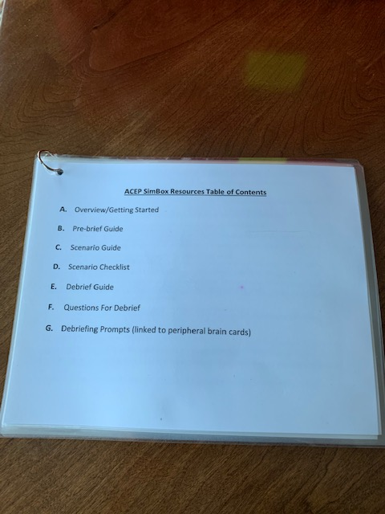
SIMBOX resources guide --This card set is designed to give you specific scripts to use throughout the sim.

Slide 24
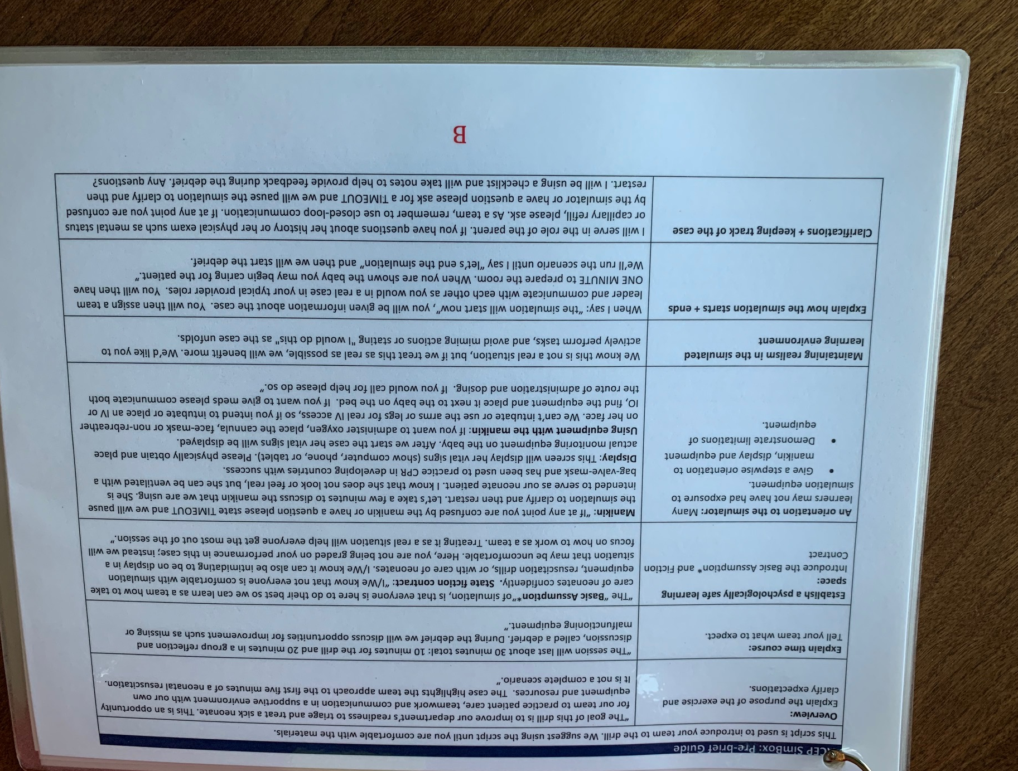
SIMBOX resources guide --This card set is designed to give you specific scripts to use throughout the sim.
Pre brief scripts (page B)-These are specific scripts to help set the scene for the sim. This covers the core principles previously discussed.

Slide 25
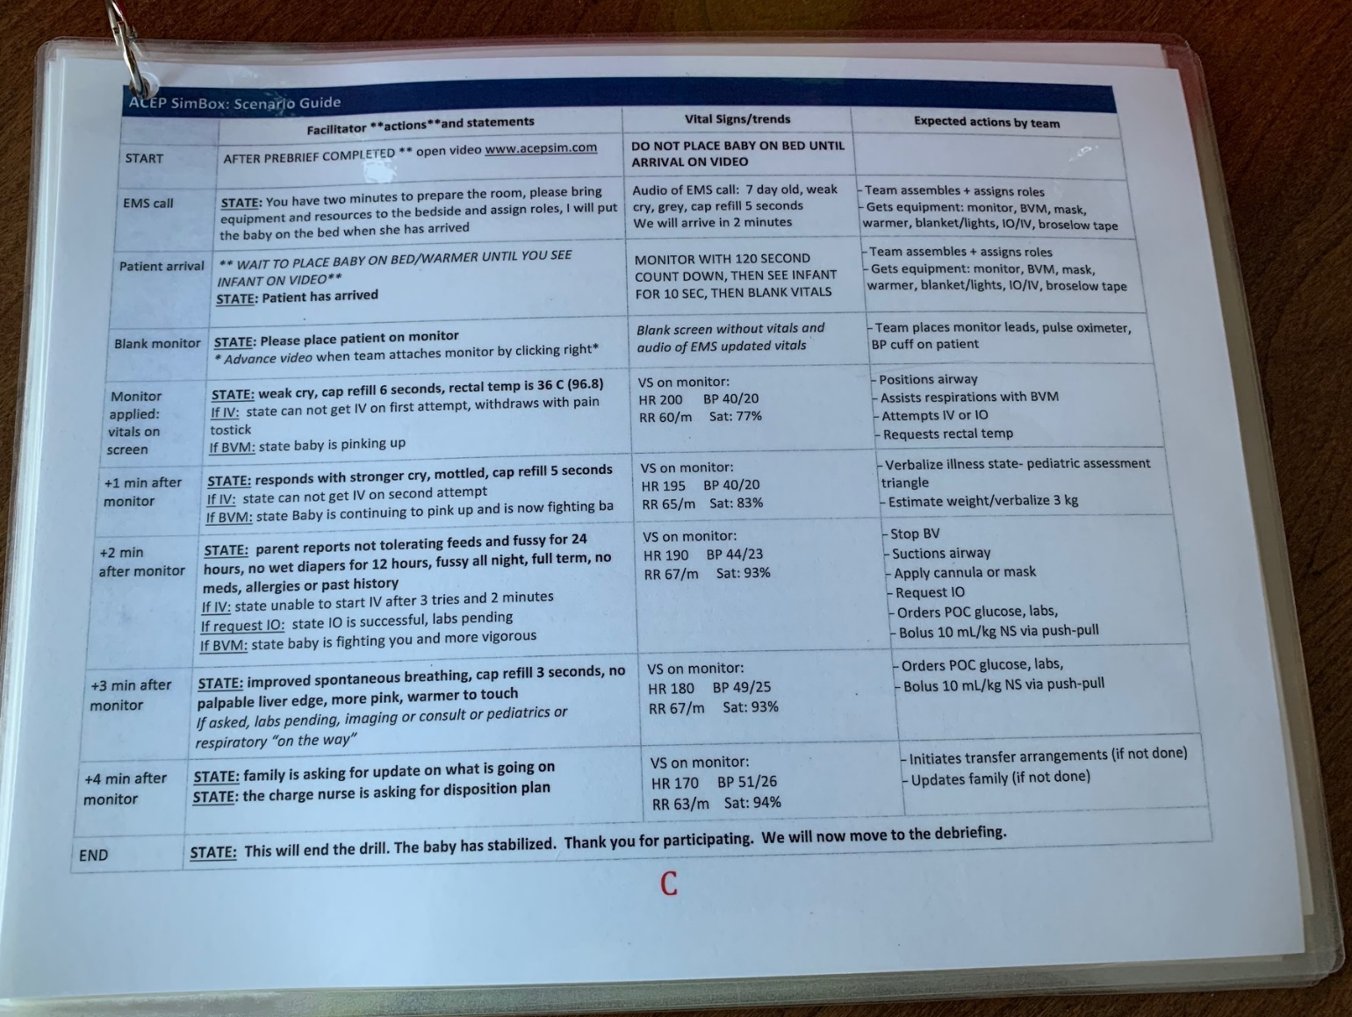
SIMBOX resources guide --This card set is designed to give you specific scripts to use throughout the sim.
Scenario guide (page C)-Runs the case in chronologic order what will happen at each major event point
Tip: If you are able to have a helper, as a first timer, it is helpful to have someone run the sim for you while you take notes on how the case is running
Tip: If things are not going well or you feel like you have reached an impasse in the case, you can “pause” the scenario to help team get back on track.

Slide 26
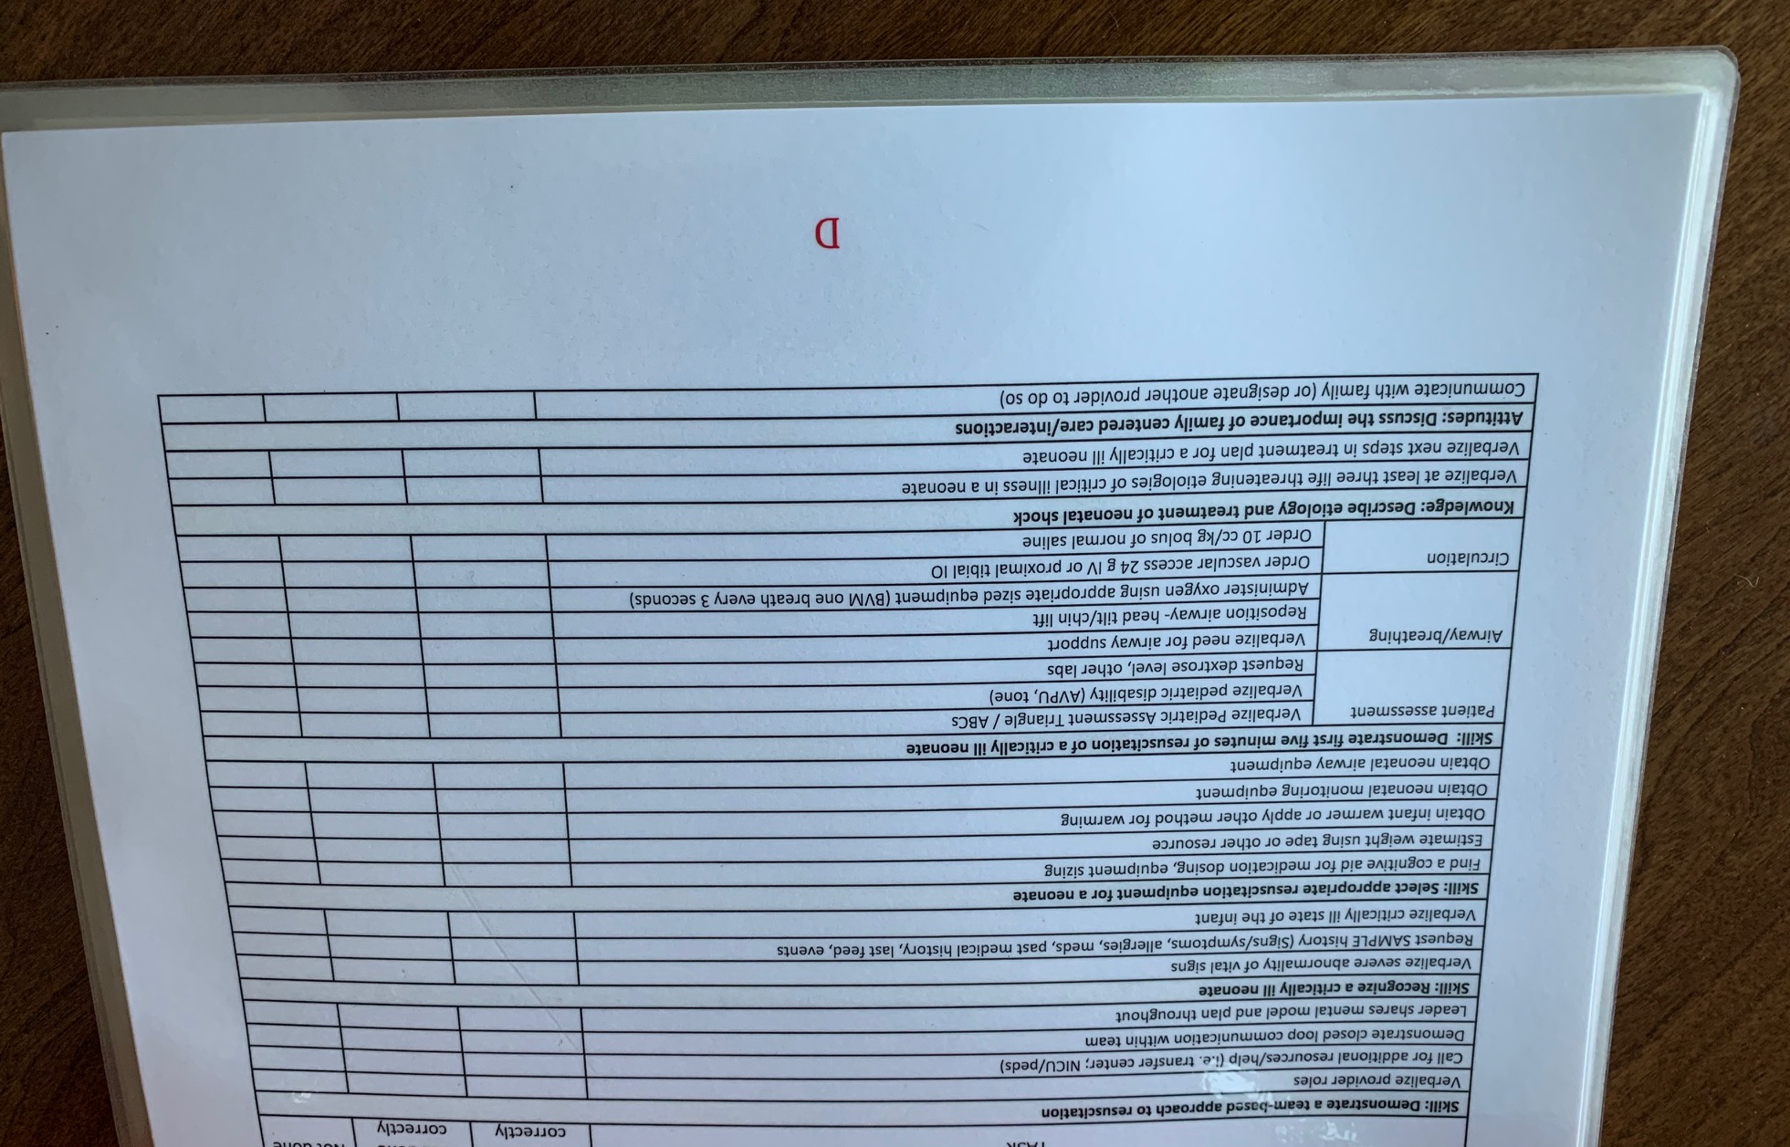
SIMBOX resources guide --This card set is designed to give you specific scripts to use throughout the sim.
Scenario checklist (page D)- This is a guide of what to look for while the case is running

Slide 27
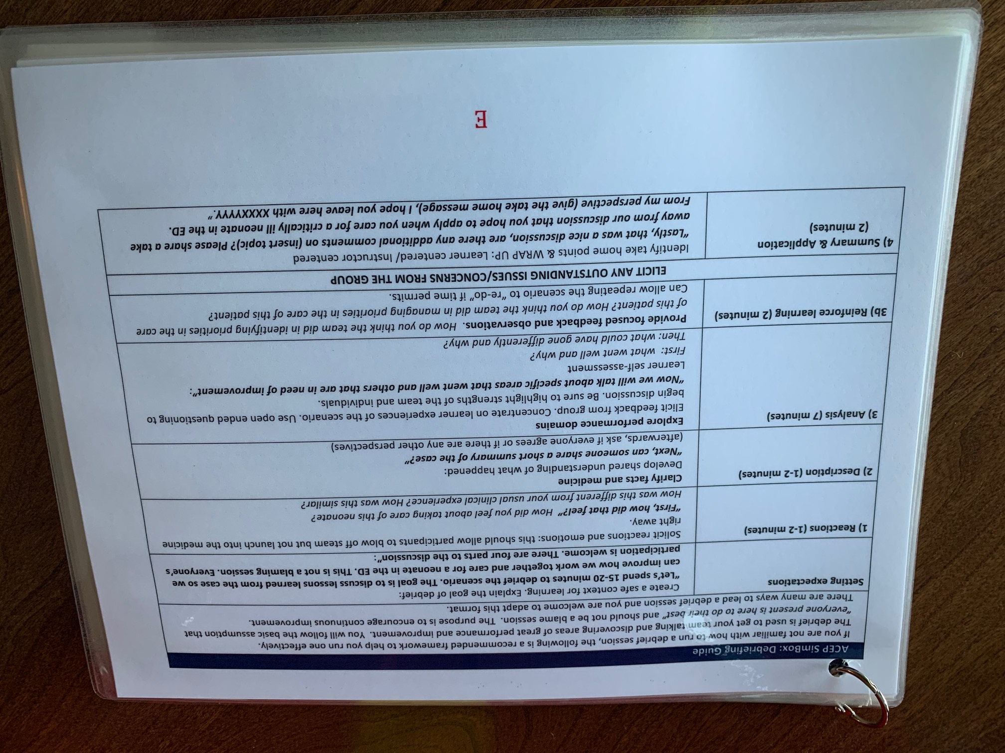
SIMBOX resources guide --This card set is designed to give you specific scripts to use throughout the sim.
Debrief guide (page E-G)-This provides specific scripts and questions that you can use during debrief after sim in the format as above

Slide 28
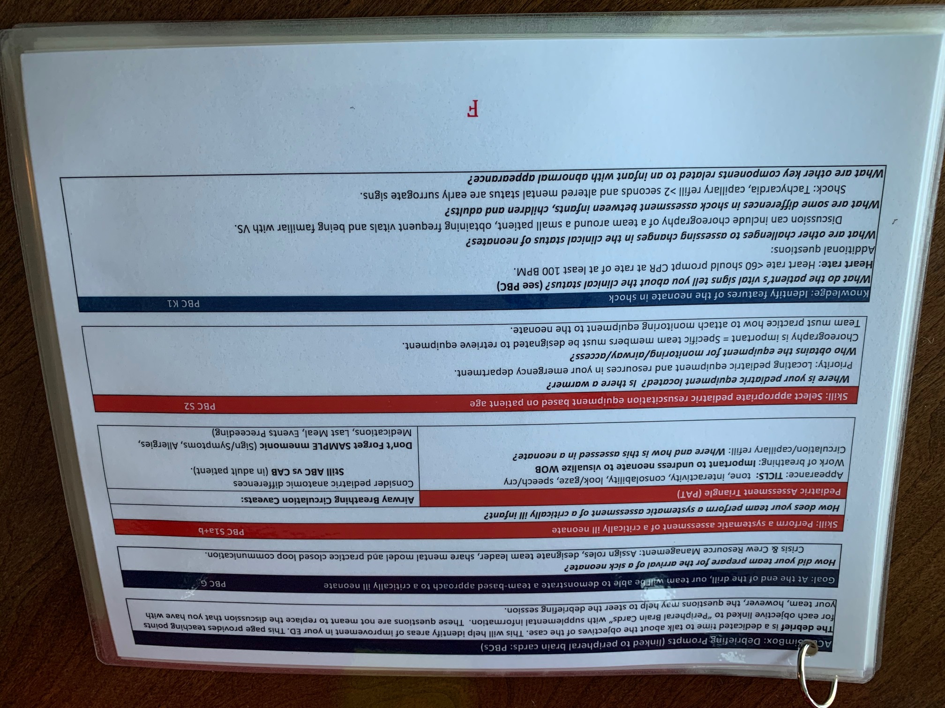
SIMBOX resources guide --This card set is designed to give you specific scripts to use throughout the sim.
Debrief guide (page E-G)-This provides specific scripts and questions that you can use during debrief after sim in the format as above

Slide 29
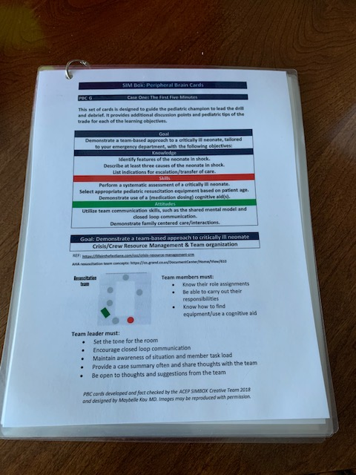
Peripheral Brain Cards --Additional knowledge cards
We recognize not everyone is going to be a pediatric expert so these cards are to help supplement your knowledge around identifying and caring for a sick neonate
They organized into sections:
Goals
Attitudes
Skills
Knowledge
Notes:
Pic of card with pbc on right upper hand corner and pick of corresponding pbc

Slide 30
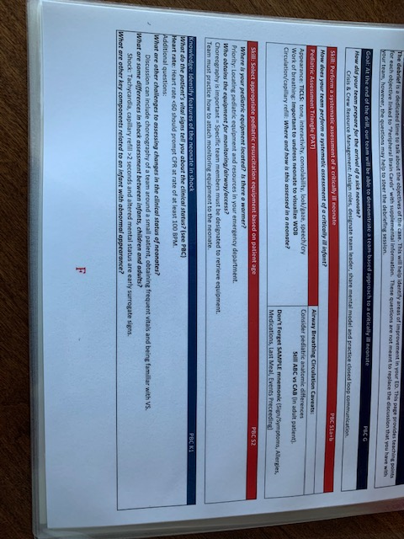
Peripheral Brain Cards --Additional knowledge cards
These cards provide support to the debrief cards in the resource guide.
For example:
Notes:
Pic of card with pbc on right upper hand corner and pick of corresponding pbc

Slide 31
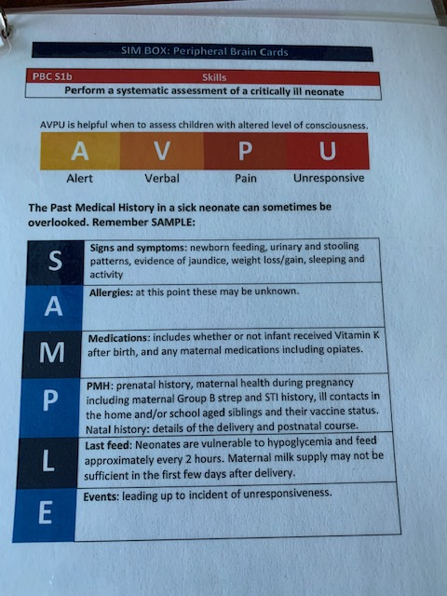
Peripheral Brain Cards

Slide 32
Videos
https://www.acepsim.com/

Slide 33
Next steps
The next step is to try to run one!
Review the cards and the 2 videos
Consider running at a low volume but high provider time (e.g. change of shift, particularly morning shift)
Sign up for a time to have virtual co-facilitator
You can run multiple times

Slide 34
Questions?
Thank you for your time!

