Slide 1


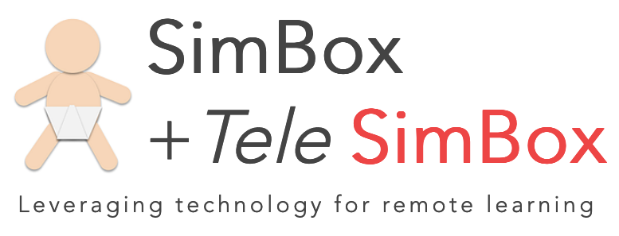


TeleSimBox: Effective For Medical Student Education During Time of COVID-19
Authors: Elizabeth Sanseau, MD, MS,¹ Megan Lavoie, MD,² Khoon-Yen Tay, MD,³ Grace Good, RN, BSN, MA,⁴ Suzana Tsao, DO,⁵ Rebekah Burns, MD,⁶ Anita Thomas, MD, MPH,⁷ Tanner Heckle, MD, MPH,⁸ Meghan Wilson, MD, MPH,⁹ Maybelle Kou, MD, MEd,¹⁰ Marc Auerbach, MD, FAAP, MSc¹¹
^{1, 2, 3, 4} Children’s Hospital of Philadelphia, ⁵ University of Pennsylvania School of Medicine, ^{6, 7, 8} Seattle Children’s Hospital/University of Washington,
¹⁰ George Washington School of Medicine, ^{9, 11} Yale School of Medicine
Acknowledgements: ACEP TeleSimBox core team, Megan Schultz, MD, Abigail Schuh, MD, Jean Pearce, MD of the Medical College of Wisconsin
IPSSV2020
Background
COVID-19 pandemic restricted in-person educational opportunities for medical students (1)
Sudden need for remote teaching tools
Telesimulation educators have demonstrated feasibility and success in achieving learning objectives (2)
Figure 1. Student perception of the ability of the simulations to achieve specific learning objectives, Modified Simulation Effectiveness Tool (SET-M)
Figure 2. Comparison of telesimulation
to other distance learning modalities
and in-person simulation
Results
29/30 (97%) Faculty, 67/300 (22%) Medical Students completed surveys
Faculty NPS: +66, Student NPS +41
Faculty respondents agreed was easy to use
All sessions completed on schedule without significant technology issues
Goals/Objectives
To develop free, open-access medical education peer-reviewed telesimulation case bundles (3) designed for medical student learners that include:
    facilitator guide
    prebrief/debrief scripts
    scenario
    checklist
    resources
Conclusions
Feasible, effective, comparable to other distance learning and in-person simulation
Promoted by both faculty and students
Moving into the COVID-19 and post pandemic world, telesimulation tools must be studied and iteratively improved to maximize usability, accessibility, and educational effectiveness
Methods
Prospective observational study
Convenience sample of medical students and faculty
Twenty-one sessions of Pediatric Seizure case over three months with 30 faculty, 300 students across four medical schools
Post-sim surveys: Modified Simulation Effectiveness Tool (SET-M) (4), 3-point Likert scale questions and the Net Promoter Score (5)
Figure 3. Screenshot of simulation session
References 1. Ahmed, Hanad, et al. "COVID-19 and medical education." The Lancet Infectious Diseases (2020). 2. Henao, O, et al. Fundamentals of laparoscopic surgery in Columbia using telesimulation: an effective educational tool for distance learning. Biomedica 2013. 3. https://www.acepsim.com/
4. Leighton, K., et al. Update the Simulation Effectiveness Tool: Item modifications and reevaluation of psychometric properties. Nursing Education Perspectives. 5. Hamilton, D. F., et al. "Assessing treatment outcomes using a single question: the net promoter score." The bone & joint journal 96.5 (2014).

