Slide 1
TeleSimulation: An Effective Distance Alternative For Experiential Learning For Medical Student Education
Presenters: Elizabeth Sanseau, MD, MS, Tanner Heckle, MD, MPH
Co-Authors: Marc Auerbach, MD, FAAP, MSc, Maybelle Kou, MD,
Megan Lavoie, MD, Khoon-Yen Tay, MD, Suzana Tsao, DO, Grace Good, MA,
Rebekah Burns, MD, Anita Thomas, MD, MPH
Notes:
LIZ
TeleSimulation: Acceptable and Feasible For Medical Student Education During Time of COVID "Elizabeth Sanseau, Megan Lavoie, Khoon-Yen Tay, Grace Good, Suzana Tsao, Rebekah Burns, Anita Thomas, Tanner Heckle, Maybelle Kou, Marc Auerbach" https://weillcornell.zoom.us/j/95760309795 285559

Slide 2
Introduction
Simulation is an effective way to:
Transfer medical knowledge
Develop teamwork/communication skills
Work on leadership
COVID-19 pandemic introduces new challenges for training
People cannot all be in the same location
Is a simplified version of telesimulation feasible and acceptable as a form of learning when learners are separated by distance?
Notes:
TANNER

Slide 3
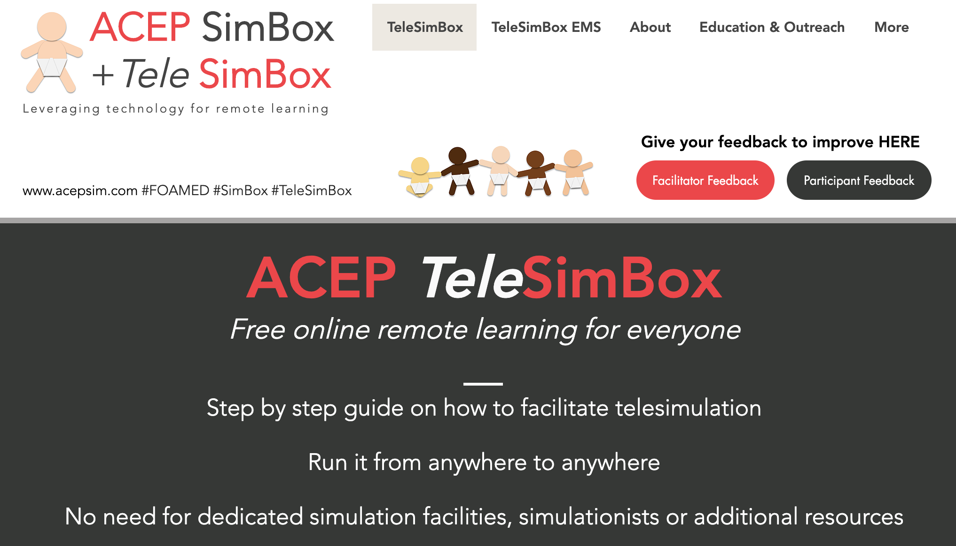
ACEP Simbox
Developed pre-COVID-19 pandemic
Free Open Access Medical Education (FOAMed)
Low resource: no simulation lab, manikins, technologists or professional handlers
Notes:
LIZ
“meal delivery service” of simulation

Slide 4
Facilitate Across Sim Spectrum
Notes:
LIZ
During COVID, broadened the delivery service across the sim spectrum

Slide 5
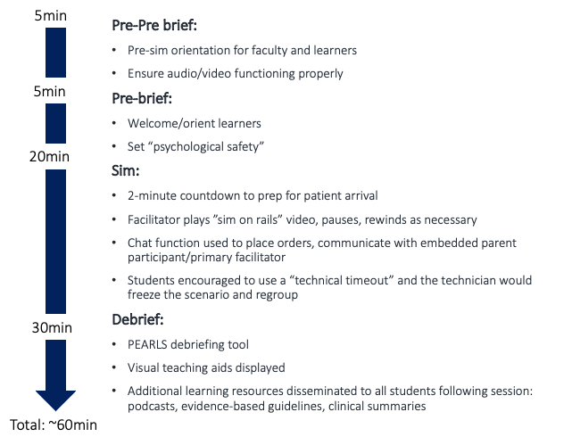
Resources
Notes:
LIZ
Standardizing an approach to telecommunicating (new for many of us) a simulated medical scenario.
Written for both experienced and novice facilitators alike.
Provided online: pre-brief orientation, scripts of prebrief/debrief, and scenario guide
Sim on rails: facilitator streams YouTube video of the patient and monitor that trends vital signs over time, but does not change in response to interventions. To run: simply start/pause/stop/rewind.
If the participants meet all case learning objectives in a timely fashion, the vital sign trend on the streaming video needs no manipulation. If the participants do not do an intervention, e.g., do not apply oxygen or do not give an antiepileptic medication, the facilitator rewinds the video to delay the progression in vital signs on the video stream. This can be done fast, without a significant pause or delay on the streaming video.
This differentiates from traditional simulation with a handler who responds to participant stated actions which requires higher costs, technologists, and more advanced training of facilitators.

Slide 6
How To
1. Write a script
2. Video the patient
3. Build the monitor
Two facilitators
Three participants
A lot of support
Notes:
TANNER

Slide 7
Let’s Visit The Website

Slide 8
Prospective, Observational Study
Participants:
30 faculty and 300 medical students recruited via peer networks across four United States medical schools
University of Pennsylvania, Yale University, University of Washington, and the Medical College of Wisconsin
21 telesimulation drills of “Pediatric Seizure”, over 3 months
Data collection:
Post-participation survey: questions from the Modified Simulation Effectiveness Tool (SET-M), Likert Scale questions, Net Promoter Scores (NPS), open-ended response
Notes:
TANNER

Slide 9
Students Still (Do Not) Like To Complete Surveys
78%
Not Completed
Notes:
TANNER
300 medical students participated in total
67/300 (22%) of the medical students and 29/30 (97%) of the facilitators completed the post-telesimulation surveys.
Of the 29 facilitators, 28 were physicians and 1 a nurse and simulation educator.
All worked at moderate to high-pediatric volume (>50 children per day) academic children’s hospitals with residency and fellowship training programs.
The physician facilitators were made up of 6 Residents, 9 Fellows, 1 Faculty Instructors, 8 Faculty Assistant Professors, and 4 Faculty Associate Professors.
This was an experienced and highly trained group of simulation facilitators, and most (26/29 (90%)) had completed a simulation/debriefing course and 12/29 (41%) had facilitated more than 20 sims in the prior year.

Slide 10
Medical Students With Various Interests
Internal
Medicine
22%
Other
40%
Pediatrics
22%
Family Medicine
2%
Neurology
2%
Surgery
9%
Med Peds
3%
Notes:
TANNER
The 67 medical student participants who responded to the survey expressed plans to pursue specialties in Internal medicine (15), Pediatrics (15), Surgery (6), Neurology (1), Med-Peds (2), Family medicine (1), and Other (27).
The range of clerkship and simulation experience of the participants was broad. One quarter had completed their Emergency Medicine clerkship, 20% had completed their Pediatrics clerkship, and only 1 had completed a Pediatric sub-internship. Most (64/67) had participated in few (<10) simulations prior to the session, 39/67 had participated in some sort of “tele-virtual/remote simulations” and 15/67 had participated in “in-person pediatric simulations.”

Slide 11
Prebrief
Notes:
LIZ
Modified Simulation Effectiveness Tool (SET-M)
Validated modified simulation effectiveness tool SET-M with medical and nursing students.

Slide 12
Debrief
Notes:
LIZ
The debrief is where learners really consolidate their learning.
Data that shows without debrief you have minimal learning in a sim session.
The debrief was perceived to be a constructive evaluation of the simulation, provided the opportunity to self-reflect on performance, helped with clinical judgment, allowed space to verbalize feelings before focusing on the scenario, and overall contributed to learning.
SET-M

Slide 13
Students
Notes:
LIZ
Strongly agreed that felt prepared to respond to patient’s changing condition, better understanding of medications, practice clinical decision making, and reporting information to their team.
Somewhat agreed with the statements: better understanding of pathophysiology, empowered to make clinical decisions, teaching and communicating with families, and confidence in patient safety interventions.
We designed the sim with specific learning objectives around crisis resource management, family communication and medical knowledge (ABCD’s benzos) –
So while I expected to see lower scores in the patient safety and pathophysiology realms, interesting to see telesimulation not as successful in family communication/teaching.

Slide 14
Students
Notes:
LIZ
Our own 3-point Likert scale questions.
Students positively perceived the tool to be efficacious in improving acute care comfort, skills and teamwork/communication; however, students responded less positively when asked if the tool was efficacious teaching psychomotor skills.
However, the literature there are numerous examples of telesimulation/facilitation effectively teaching psychomotor skills.

Slide 15
Facilitators
Notes:
LIZ
Facilitators responded to Likert-scale questions positively in the realms of perception in teaching acute care comfort, skills, teamwork/communication, family-centered care, and acute care knowledge.

Slide 16
Net Promoter Score (NPS)
+ 66
+ 41
Notes:
LIZ
The overall facilitator NPS was +66 and the student NPS was +41.
In addition, facilitators either somewhat agreed (8/29) or strongly agreed (20/29) that the tool was easy to learn how to use (one did not answer).
One commented: “Overall easy to learn how to facilitate” (F3)
Nearly all facilitators and two-thirds of the students perceived the tool to be comparable to other distance learning (e.g. online lectures and discussions).
One student responded: “I would sign up for any sims offered. I think it is a much more engaging and informative format than lectures.” (P3).
When asked if the telesimulation was effective compared to in-person simulation, approximately 90% of facilitators, and one-half of the students either somewhat or strongly agreed.
Of note, nearly half of the students did not submit an answer to this question, likely because less than a quarter of the students had ever participated in an in-person simulation prior.

Slide 17
Limiting Factors
Smaller groups preferred
Difficult to communicate over each other at times
Importance of structure and expectations
Notes:
TANNER
“Having fewer learners in the session would allow everyone to participate. We had some students "observing" because there weren't enough roles for them to be able to participate” (P5).

Slide 18
Growth Opportunities
Family centered communication challenging
“I think practicing family centered care might not be the best task to practice with telesimulation - it was hard to not talk over each other. Break out rooms?” (F15).
More sophisticated video with more branch points
“The linear, non-responsive nature of the video components [was challenging]…[This] is unfortunately a limitation of the format of the session. I am not sure of the feasibility of creating a pre-made simulation such as this with "branch points" or other forms of response to the interventions initiated by the team…That said, for a relatively simple case like seizure, it worked for our group, as there were not a lot of different roads to go down and our team generally identified and performed the proper steps in the expected order” (F32)
Notes:
LIZ

Slide 19
Conclusion
Feasible
Acceptable
Effective
Promoted
Low cost
Easy to use
Notes:
LIZ
The medical students and facilitators who responded to our survey found this telesimulation experience feasible and acceptable

Slide 20
Next steps
Adapt to feedback (choose your own adventure)
Compare modalities
Trial with novice facilitators
Trial with different learners
What is the best way to study the efficacy of telesimulation tools?
Notes:
LIZ

Slide 21
Thank you.
Questions?
Notes:
LIZ

