Slide 1
ACEP TeleSimBox for EMS Free Open Access Medical Education Synchronous simulation-based learning adapted for remote learners EMS Alaska Echo Presentation March 12, 2021
Marc Auerbach, MD, MSCE, Yale University
Elizabeth Sanseau, MD, MS, Children’s Hospital Of Philadelphia
Former Pediatric Hospitalist, Yukon-Kuskokwim Health Corporation (YKHC), Bethel, Alaska
On behalf of the ACEP SimBox group
Notes:
Mar 12th EMS ALASKA ECHO
2-2:45p EST
10 min background, 15 min demo, 20 min Q&A.

Slide 2
HAPPY HAPPY BIRTHDAY TO RENEE!!!!!!!

Slide 3
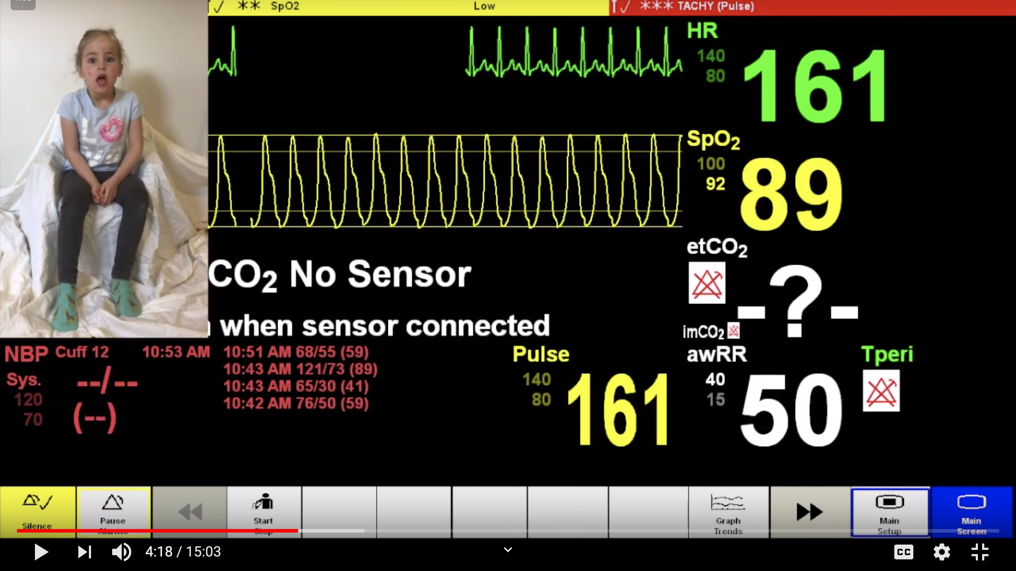
ALL IN-PERSON
ACEP SIMBOX
PARTICIPANTS & FACILITATORS IN
SAME LOCATION
CENTRE-BASED SIMULATION
SIMULATION IN THE TIME OF CORONAVIRUS
SIMULATION=BASED EDUCATION
IN-SITU SIMULATION
PARTICIPANTS & FACILITATORS IN DIFFERENT LOCATIONS
“TELE-SIMULATION”
Notes:
This is not designed to replace traditional sim centers in places with those amazing resources.
This is a way to access peer reviewed, free, and easy-to-use experiential learning tools wherever you are.
Originally conceived as way to bring FOAMed to those without access to sim center who can’t travel to a course.

Slide 4
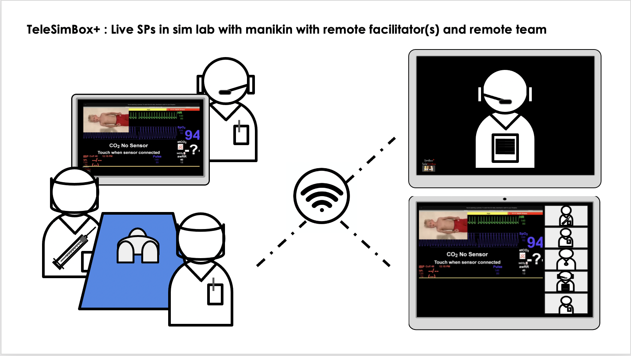
ALL IN-PERSON, ALL REMOTE, HYBRID
ACEP TELESIMBOX
PARTICIPANTS & FACILITATORS IN
SAME LOCATION
CENTRE-BASED SIMULATION
SIMULATION IN THE TIME OF CORONAVIRUS
SIMULATION=BASED EDUCATION
IN-SITU SIMULATION
PARTICIPANTS & FACILITATORS IN DIFFERENT LOCATIONS
“VIRTUAL / REMOTE / DISTANCE / TELE”
SINGLE-LEARNER VR / AR / GAMES
MARIONETTE SIM
SIM CENTER WITH ACTORS CONNECT TO REMOTE LEARNERS
ONLINE / TELECONFERENCE
LEARNER + FACILITATOR
FACILITATOR GUIDED SCREEN SHARE
COLLABORATIVE ONLINE ENVIRONMENT
LEARNERS “COMPLETE ACTIONS” BY CLICKING, DRAGGING, TYPING.
FACILITATORS DO SAME TASKS AS IN SIM LAB (VITALS, PROMPTS)
EX: VIRTUAL RESUS ROOM
Notes:
In COVID adapted content to be used across spectrum of all in person, all remote, and a mix.
Who: facilitators and/or creators (PEM docs, fellows, residents with or without sim expertise)
Who: learners (students, residents, fellows, faculty, EMS, interprofessional education)
Where: all online, in community ED, in community ED (partner sites), in community ED (nonpartner- outreach), EMS
Why: off the shelf simulation that can be done anywhere/anytime without need for sim center/technician/resources/sig planning
Relevance: even more needed in this COVID and post COVID world

Slide 5
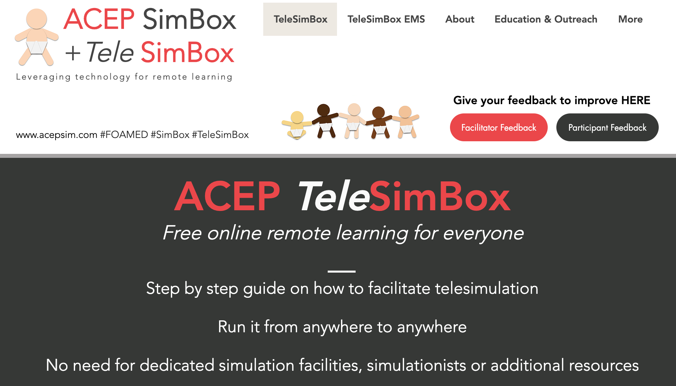
ACEP SimBox https://www.acepsim.com/
Notes:
When: You are on a “slow” shift and have a new trainee or just want some practice to be better prepared to respond to the next sick pediatric patient call --
Could use a white board and discuss a case OR do SimBox!
How: Click on site, download case PDF with corresponding YouTube video.
Here is the website and QR code that will link you there.

Slide 6
Set Up – all in person
Set up
2. Facilitator sets up internet streaming device at head of bed and plays YouTube video to start simulation
1. Facilitator sets up manikin, equipment in situ
Notes:
Easy to use on your next shift

Slide 7
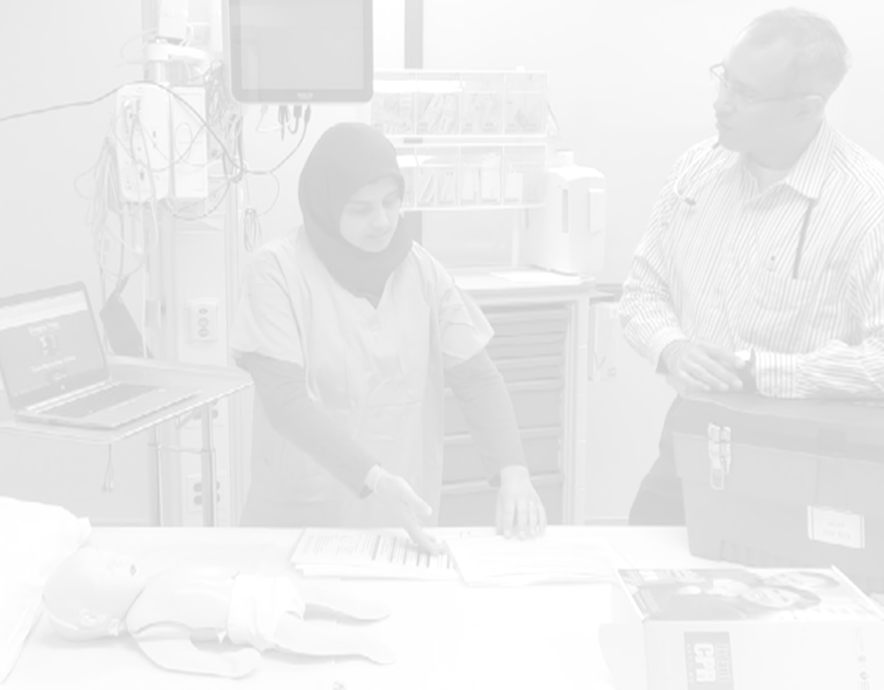
How to – all in person
Prior: review materials
Prebrief
Play YouTube video
Debrief
Notes:
Sim on rails: facilitator streams YouTube video of the patient and monitor that trends vital signs over time, but does not change in response to interventions. To run: simply start/pause/stop/rewind.
If the participants meet all learning objectives in a timely fashion, the vital sign trend on the streaming video needs no manipulation. If the participants do not do an intervention, e.g., do not apply oxygen or do not give a medication, the facilitator rewinds the video to delay the progression in vital signs on the video stream. This can be done fast, without a significant pause or delay on the streaming video.
This differentiates from traditional simulation with a handler who responds to participant stated actions which requires higher costs, technologists, and more advanced training of facilitators.

Slide 8
Set Up – in person learners + remote facilitator
Set up
Device #1 positioned at head of bed for participants to see streaming video
(controlled by remote facilitator)
On the ground champion: sets up manikin, equipment, & devices connected to same Zoom conference, ensures audio/visuals work ahead of time
Device #2 positioned to capture video of participant actions
Notes:
Here is an example of how one might set up their in-situ SimBox with a remotely located facilitator tele-commuting in.
Flexible to use across the sim spectrum – all in person, + remote facilitator, all remote
To shift to remote, on the ground facilitator adds Device #2 and connects to remote co-facilitator.

Slide 9
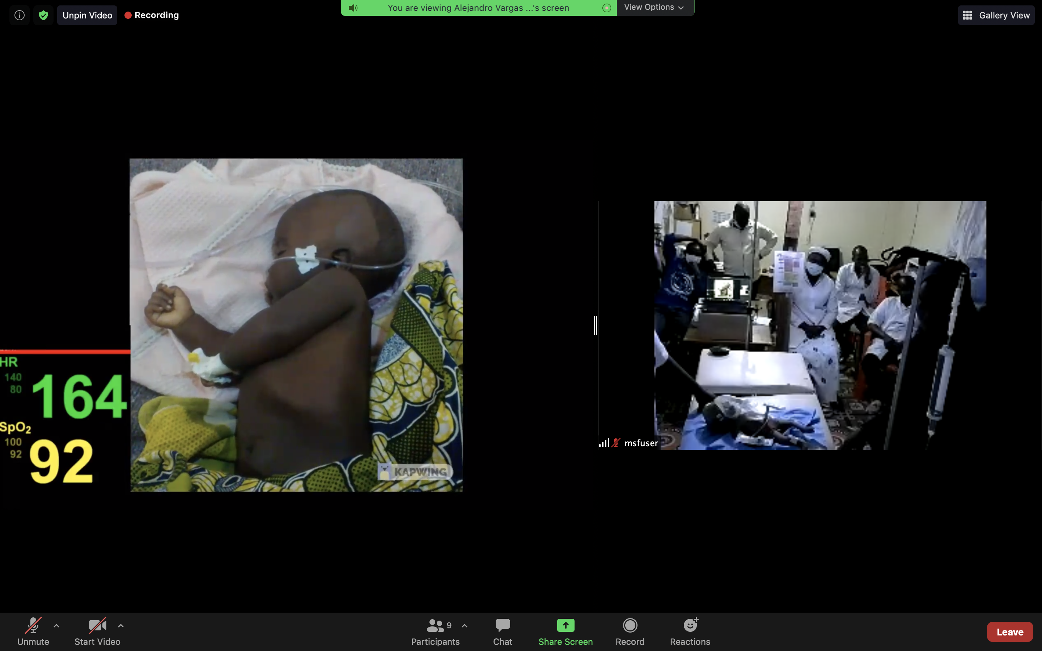
How to – in person learners + remote facilitator
Observers watch
as a train the trainer
Facilitator #1
leads prebrief and sim
Facilitator #2 embedded participant, leads debrief
Shared Video
Video of patient superimposed on monitor that is shared and controlled by remote facilitator
Participants in action
On the ground Supervisor as “Champion” who sets up mannikin and 2 streaming devices prior to session for learner participants and co-facilitates
Notes:
Screenshot of remote facilitator’s shared screen running a blended sim – participants together around mannikin in their natural work settings, facilitator(s) remotely connecting.
Magaria, Niger, MSF

Slide 10
How to – all remote
Facilitator shares screen, plays video to entirely remotely connecting participants + co-facilitator
Participants talk through actions
Notes:
This pic is a screenshot using with student learners with all remote during COVID with strict restrictions to in-person meetings.

Slide 11
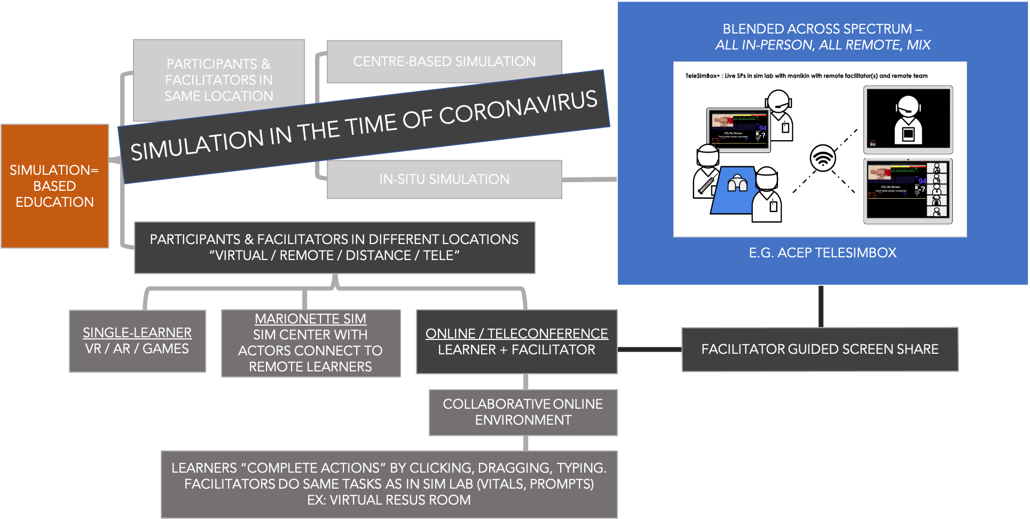
SIMULATION BEYOND CORONAVIRUS

Slide 12
Scholarship (2020)
Medics
Nurses
Medical students
Residents
International humanitarian healthcare workers
Next steps (2021 +)
Where there is no pediatric training
Notes:
Research conducted during pandemic -
Perceived effective (SET-M, Likert Scale), Promoted (Net Promoter Score), Feasible in these settings.
Alaska Native System
IHS/Tribal
Argentina, DR, Puerto Rico
Magaria, Niger, MSF
Vellore, India, PediSTARS
… high school students in West Philly through Outward bound
… EM resident trainees lacking pediatric emergency simulation-based training
Where are we going with this?
Primary interest is working to bring this resource to those community EDs, health centers, EMS groups CURRENTLY NOT DOING PEDIATRIC TRAININGS (run in person with remote facilitator)
Not making sim centers obsolete. This is not to replace traditional sim.
Simply cannot have experts everywhere anytime.
This is a way to connect experts to learners across the globe.
Interested in building relationships and training trainers, including novice sim facilitators.
I’m curious to know in a scholarly sense who can be trained to run these (nurses, medics, community health aides, high school students?)
The SimBox group thinks outside the box – how can we creatively push the norm in order to break down these barriers to simulation.
[Compass image: https://commons.wikimedia.org/wiki/File:Modern_Nautical_Compass_Rose.png]

Slide 13
Let’s practice
https://www.youtube.com/watch?v=-sOW1OvrHP0&feature=youtu.be
Notes:
3 volunteers
Thank you
I will be the facilitator lead.
My co-facilitator Marc is embedded in the scenario – he is an experienced ER nurse.
As the lead, I will start the video with the prebrief, you will hear an intro and a dispatch call, and you will see a 2 min countdown clock.
Use those 2 minutes to assign each other team roles and gather any equipment, medications, or cognitive aides that you would need as if you were responding to a real patient scenario.
At the end of the 2 minutes you will see a video of a monitor and patient – this is when the scenario begins.
Communicate outloud with your team. The embedded nurse will be your eyes and ears – if you want vital signs, monitors connected, physical exam findings, access, or medications delivered, ask him/her and they will respond.
If you want any information from the parent ask outloud and we will provide that history.
If you are ever confused about the technology or case in general, please feel free to call a ”Timeout” and we will regroup.
As always with sim, we are working under the basic assumption that everyone participating is intelligent, capable and cares about doing their best and wants to improve.
Any questions before I start the video?

