Slide 1


TELE SimBox
Elizabeth Sanseau, MD, MS
Fellow, Pediatric Emergency Medicine & Global Health
Children’s Hospital of Philadelphia
Notes:
Slide 1:
Thank you for having me.
I have had a lot of fun working on modifying the ACEP SimBox to be used as a telesimulation tool.
This project started as a FOAMEd simulation initiative targeted at community ER providers who can sign up and receive a free blow up mannikin and on-line resource guides to facilitate sims on their own.
In a response to my ER friends and colleagues working in the Indian Health Service who specifically asked for tele-co-facilitation help with their new ACEP SimBoxes, we successfully piloted a tele-faciliation trial before this pandemic - with just one remote facilitator (myself) and the ER team all together in person at their respective IHS facilities.
Then COVID happened - Navajo ER providers are extremely busy with clinical work - but now there is an expressed need with med student clerkship for something, easy, accessible, and ready to go now to fill the sim void for this specific trainee group.
We have modified the sim materials to meet this need and have developed the TELE SimBox which we will be trialing with all remotely located facilitators/participants.
NEXT SLIDE PLEASE

Slide 2
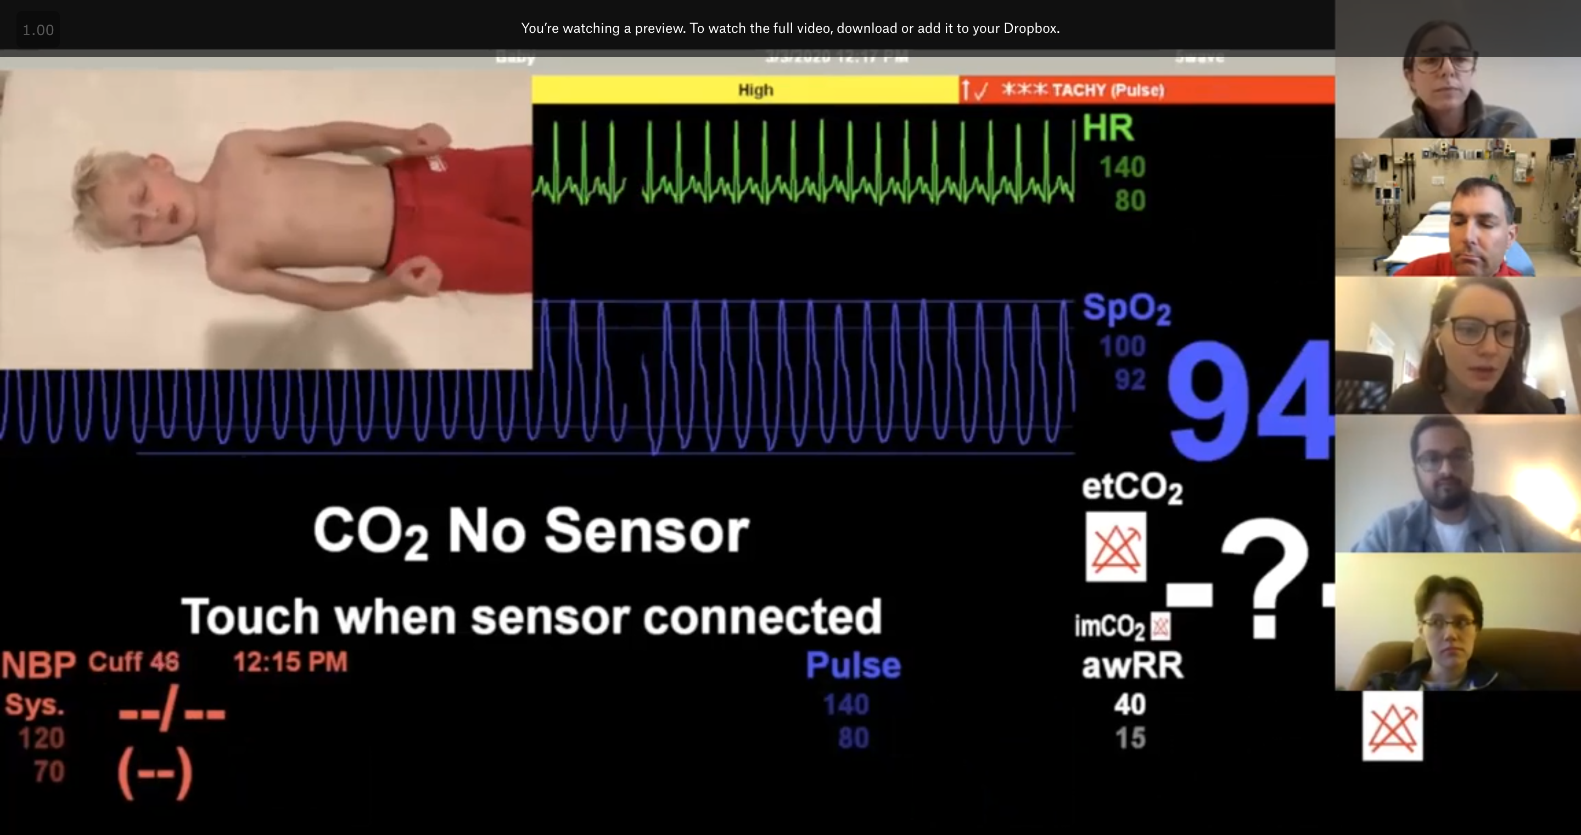
Screen share view
ACEP TELE SimBox: an alternative to high tech sim
Streaming device
Internet
Video conference tool
FOAMEd resources: https://www.acepsim.com/
2 co-facilitators
  Pre-brief, runs video, debrief, parent
  Embedded nurse participant
3-6 participants
  3 Sim participants
  Others: observe & feedback
Checklist
Notes:
Slide 2:
What you need:
Nothing new!
Device: Computer / laptop / tablet / phone
Internet
Video conferencing (ie: Zoom)
NEXT SLIDE PLEASE

Slide 3
Tricks Tips Challenges
May, June, July ---- Future
5min
Pre-Pre brief:
Video/pre-sim orientation for faculty and learners
Pre-brief:
Most important step to welcome/orient learners
Sim:
Technical ”TIMEOUT”
Embedded nurse can make suggestions in line with LO’s
Debrief:
Share screen with materials to enrich discussion
Active feedback from the observers
Send out FOAM to learners – podcast, bottom line summaries, clinical algorithms, articles
Pilot med student implementation
Trial in resource-limited settings
5min
20min
Facilitator Surveys
Decrease Barriers
40min
Participant Surveys
Improve Patient Outcomes
Total: ~70min
Future
Notes:
Slide 3:
“Recipe book” is FOAMed resources on website, ie: Video/pre-sim orientation for faculty and learners, facilitator guide and resources https://www.acepsim.com/
Like Tom Yang’s – same number participants, similar timing, but our project is in its infancy only piloted and about to start with med students this week.
Ideally 3-6 / session ~70mins - larger groups split participants/observers.
Tips/Tricks:
Like Tom, create psychological safely in pre-brief most important.
If interventions not made, facilitator rewinds video
Co-facilitators “behind the door” WhatsApp or text to communicate.
Zoom: Gallery view, Observers hide video
Adjust volume on YouTube video itself if vital signs too loud
Challenges:
Similar to Tom – over talking with participants (so taking time in the pre-brief is important). We present this as a great opportunity to practice teamwork/communication skills.
Chat Box to communicate with parent to get around cross talk.
How simple is too simple? How fancy should we get? Embedded stills / videos of interventions? Thoughts for next steps.
The vision is to keep this low-tech to be able to trial in resource-limited settings.
The more input from user groups we can get to learn from each other, the better.
NEXT SLIDE PLEASE

Slide 4
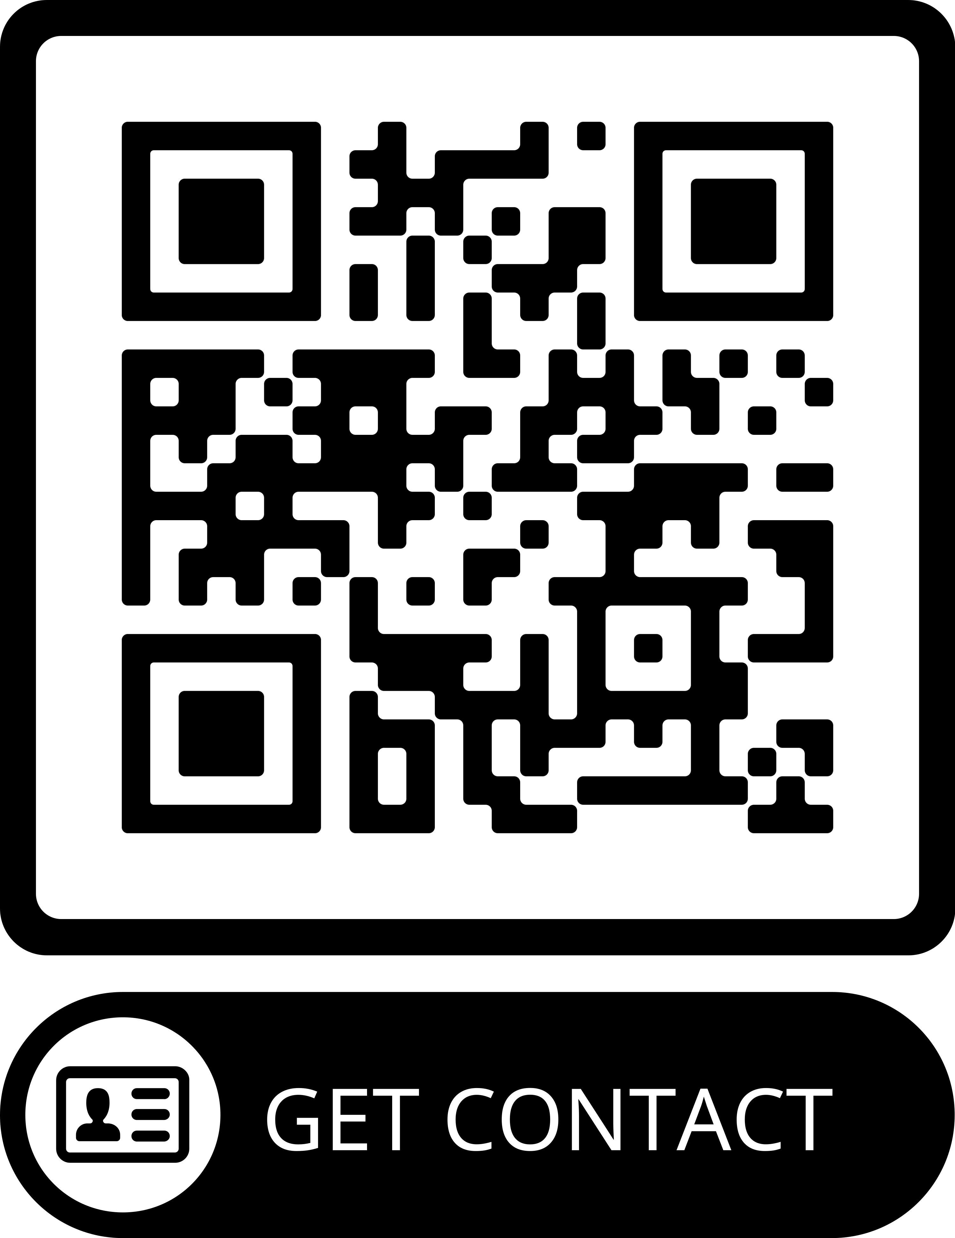
Thank you!
Interested in getting involved in telesim projects and/or medical student virtual sim?
Please contact me.
Notes:
Slide 4:
Open for all collaborations

