Slide 1
TeleSimulation: An Effective Distance Alternative For Experiential Learning For Medical Student Education
Presenter: Elizabeth Sanseau, MD, MS
Children’s Hospital of Philadelphia, PA
Fellow, Pediatric Emergency Medicine and Global Health
Co-Authors: Tanner Heckle, MD, MPH, Marc Auerbach, MD, FAAP, MSc, Maybelle Kou, MD, Megan Lavoie, MD, Khoon-Yen Tay, MD, Suzana Tsao, DO, Grace Good, MA, Rebekah Burns, MD, Anita Thomas, MD, MPH
The Fourth Annual Tri-State Regional Simulation Symposium
Friday September 25, 2020
Notes:
Introduce yourself/team (name, institution and title).

Slide 2
Introduction
Simulation is an effective way to:
Transfer medical knowledge
Develop teamwork/communication skills
Work on leadership
COVID-19 pandemic introduces new challenges for training
People cannot all be in the same location
Is a simplified version of telesimulation feasible and acceptable as a form of learning when learners are separated by distance?
Notes:
TANNER

Slide 3
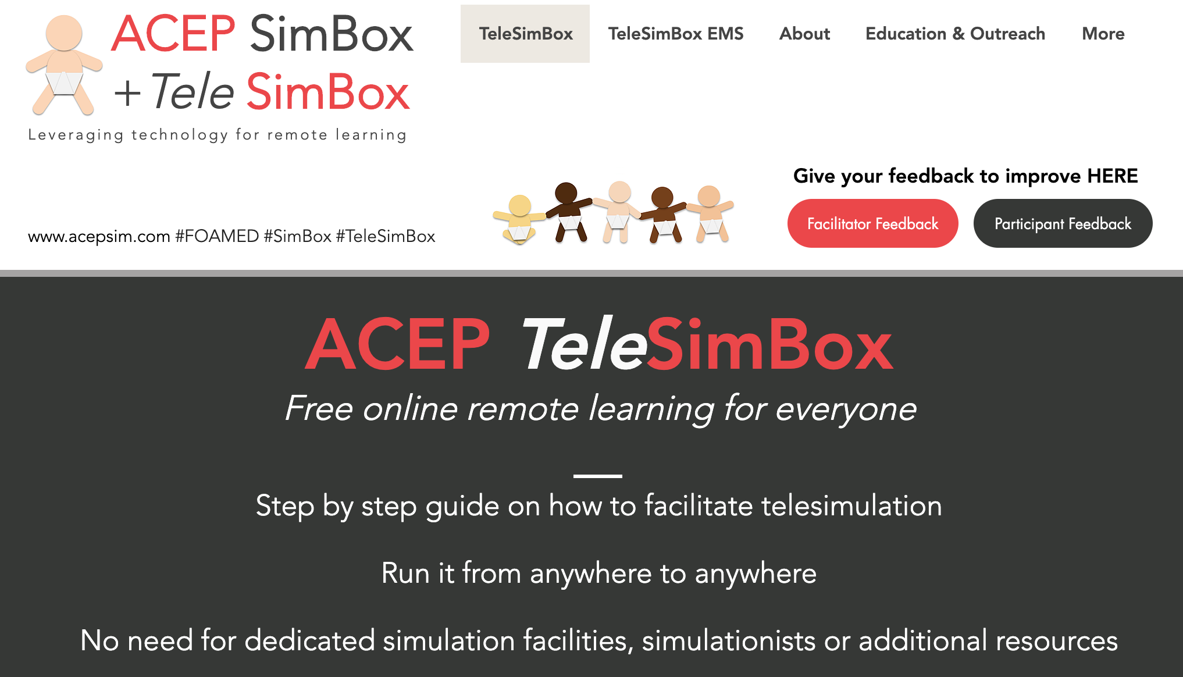
ACEP Simbox
Developed pre- COVID-19 pandemic
Free Open Access Medical Education (FOAMed)
Low resource - no simulation lab, manikins, technologists or professional handlers

Slide 4
Facilitate Across Sim Spectrum

Slide 5
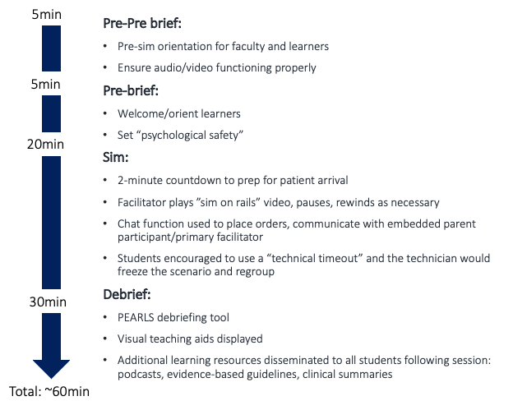
Resources
Notes:
Sim on rails: facilitator streams YouTube video of the patient and monitor that trends vital signs over time, but does not change in response to interventions. To run: simply start/pause/stop/rewind and wrap up ~10mins in.
If the participants meet all case learning objectives in a timely fashion, the vital sign trend on the streaming video needs no manipulation. If the participants do not do an intervention, e.g., do not apply oxygen or do not give an antiepileptic medication, the facilitator rewinds the video to delay the progression in vital signs on the video stream. This can be done fast, without a significant pause or delay on the streaming video, in fact most do not realize the manipulation occurred.
This differentiates from traditional simulation with a handler who responds to participant stated actions which requires higher costs, technologists, and more advanced training of facilitators.

Slide 6
How To
Write a script
Video the patient
Build the monitor
Two facilitators
Three participants
A lot of support

Slide 7
Example
Notes:
This is a group of 3 residents who have been assigned roles and are immersed in the scenario.
2 facilitators – one is the embedded nurse participant and one is the main facilitator who provides the patient history
Pull up and orient to website - https://www.acepsim.com/
https://www.dropbox.com/s/c28flcv4wbhurdv/zoom_0.mp4?dl=0
Sample video: 32-33min

Slide 8
Prospective, Observational Study
Participants:
30 faculty and 300 medical students recruited via peer networks across four United States medical schools
University of Pennsylvania, Yale University, University of Washington, and the Medical College of Wisconsin
21 telesimulation drills of “Pediatric Seizure”, over 3 months
Data collection:
Post-participation survey: questions from the Modified Simulation Effectiveness Tool (SET-M), Likert Scale questions, Net Promoter Scores (NPS), open-ended response

Slide 9
Students Still Do Not (Like To) Complete Surveys
78%
Not Completed
300 medical students participated
Notes:
67/300 (22%) of the medical students and 29/30 (97%) of the facilitators completed the post-telesimulation surveys.
Of the 29 facilitators, 28 were physicians and 1 a nurse and simulation educator.
All worked at moderate to high-pediatric volume (>50 children per day) academic children’s hospitals with residency and fellowship training programs.
The physician facilitators were made up of 6 Residents, 9 Fellows, 1 Faculty Instructors, 8 Faculty Assistant Professors, and 4 Faculty Associate Professors.
This was an experienced and highly trained group of simulation facilitators, and most (26/29 (90%)) had completed a simulation/debriefing course and 12/29 (41%) had facilitated more than 20 sims in the prior year.

Slide 10
Medical Students With Various Interests
Internal
Medicine
22%
Other
40%
Pediatrics
22%
Surgery
9%
Family Medicine
2%
Neurology
2%
Med Peds
3%
Notes:
The 67 medical student participants who responded to the survey expressed plans to pursue specialties in Internal medicine (15), Pediatrics (15), Surgery (6), Neurology (1), Med-Peds (2), Family medicine (1), and Other (27).
The range of clerkship and simulation experience of the participants was broad. One quarter had completed their Emergency Medicine clerkship, 20% had completed their Pediatrics clerkship, and only 1 had completed a Pediatric sub-internship. Most (64/67) had participated in few (<10) simulations prior to the session, 39/67 had participated in some sort of “tele-virtual/remote simulations” and 15/67 had participated in “in-person pediatric simulations.”

Slide 11
Prebrief
2
28
37
0
21
46
Notes:
SET-M

Slide 12
Debrief
0
10
57
1
12
54
1
14
52
1
10
56
0
9
58
Notes:
The debrief is where learners really consolidate their learning.
Data that shows without debrief you have minimal learning in a sim session.
The debrief was perceived to be a constructive evaluation of the simulation, provided the opportunity to self-reflect on performance, helped with clinical judgment, allowed space to verbalize feelings before focusing on the scenario, and overall contributed to learning.
SET-M

Slide 13
Students
Notes:
improve confidence in using evidence-based practice, foster safety, prioritize care and interventions, practice clinical decision making skills, understanding medications, feeling empowered to make clinical decisions, responding to a change in the patient’s condition and improve communication within the team. Scores were somewhat lower in the realm of communication with family members and better understanding of pathophysiology
SET-M

Slide 14
Students
Notes:
students positively perceived the tool to be efficacious in improving acute care comfort and skills and teamwork/communication; however, students responded less positively when asked if the tool was efficacious teaching psychomotor skills

Slide 15
Facilitators
Notes:
Facilitators responded to Likert-scale questions positively in the realms of perception in teaching acute care comfort, teamwork/communication, family-centered care, acute care knowledge and skills (Table 5).

Slide 16
Net Promoter Score (NPS)
66
41
Notes:
The overall facilitator NPS was +66 and the student NPS was +41 (Table 6).
In addition, facilitators either somewhat agreed (8/29) or strongly agreed (20/29) that the tool was easy to learn how to use (one did not answer).
One commented: “Overall easy to learn how to facilitate” (F3)
Nearly all facilitators and two-thirds of the students perceived the tool to be comparable to other distance learning (e.g. online lectures and discussions).
One student responded: “I would sign up for any sims offered. I think it is a much more engaging and informative format than lectures.” (P3).
When asked if the telesimulation was effective compared to in-person simulation, approximately 90% of facilitators, and one-half of the students either somewhat or strongly agreed.
Of note, nearly half of the students did not submit an answer to this question, likely because less than a quarter of the students had ever participated in an in-person simulation prior.

Slide 17
Limiting Factors
Smaller groups preferred
Difficult to communicate over each other at times
Structure and expectations were necessary
Notes:
“Having fewer learners in the session would allow everyone to participate. We had some students "observing" because there weren't enough roles for them to be able to participate” (P5).

Slide 18
Growth Opportunities
Family centered communication challenging
“I think practicing family centered care might not be the best task to practice with telesimulation - it was hard to not talk over each other. Break out rooms?” (F15).
More sophisticated video with more branch points
“Consider making ways to make video more engaging / reactive to participant sim: One video is the image - change the participant still/video image” (F30)
“Improve video to include interventions” (F27).
“The linear, non-responsive nature of the video components [was challenging]…[This] is unfortunately a limitation of the format of the session. I am not sure of the feasibility of creating a pre-made simulation such as this with "branch points" or other forms of response to the interventions initiated by the team…That said, for a relatively simple case like seizure, it worked for our group, as there were not a lot of different roads to go down and our team generally identified and performed the proper steps in the expected order” (F32)

Slide 19
Conclusion
Feasible
Acceptable
Effective
Promoted
Low cost
Easy to use
Notes:
The medical students and facilitators who responded to our survey found this telesimulation experience feasible and acceptable

Slide 20
Next steps
Adapt to feedback (choose your own adventure)
Compare modalities
Trial with novice facilitators
Trial with different learners
What is the best way to study the efficacy of telesimulation tools?

Slide 21
Thank you Questions?
Notes:
At the end of your group (4 presenters) please enable your video and audio to answer any questions the audience may have for you. The Moderator will direct the questions to you/your team.

